Slide 1
Bio& 241 A&P
Unit 4 Lecture 1

Slide 2
Introduction to the Nervous System and Nerve Tissue
Three Basic Functions
Sensory Functions: Sensory receptors detect both internal and external stimuli.
Functional unit: Sensory or Afferent Neurons
Integrative Functions: CNS integrates sensory input and makes decisions regarding appropriate responses
Functional Unit: Interneurons or Association Neurons of the Brain and Spinal cord
Motor Functions: Response to integration decisions.
Functional Unit: Motor or Efferent Neurons

Slide 3
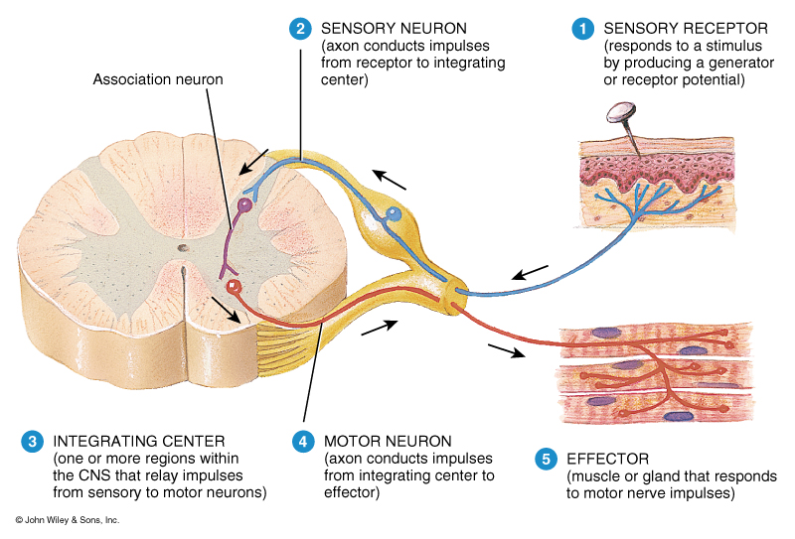
Organization of the Nervous System to supply the three basic functions

Slide 4
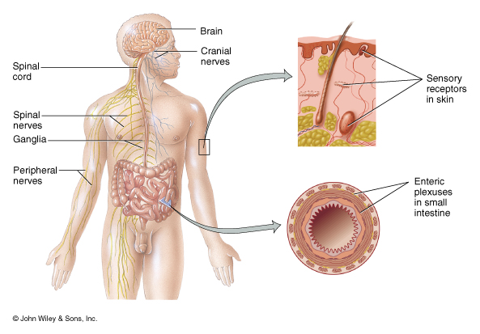
Introduction to the Nervous System and Nerve Tissue

Slide 5
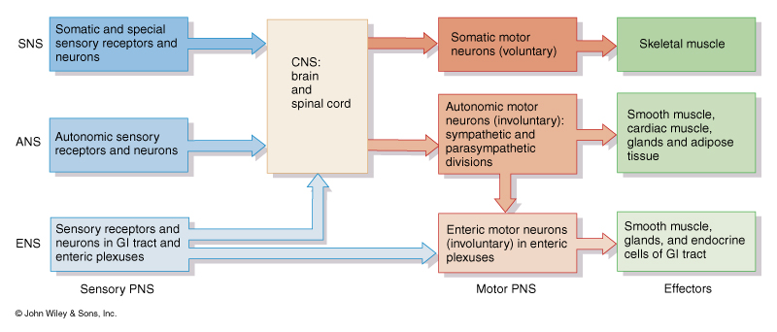
Introduction to the Nervous System and Nerve Tissue

Slide 6
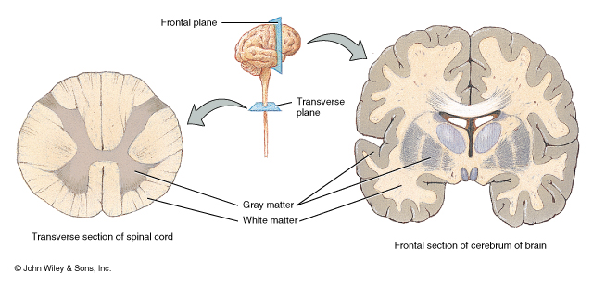
Organization of the CNS
Gray Matter: Contains neuron cell bodies
White Matter: Contains cell extensions organized into tracts
W

Slide 7
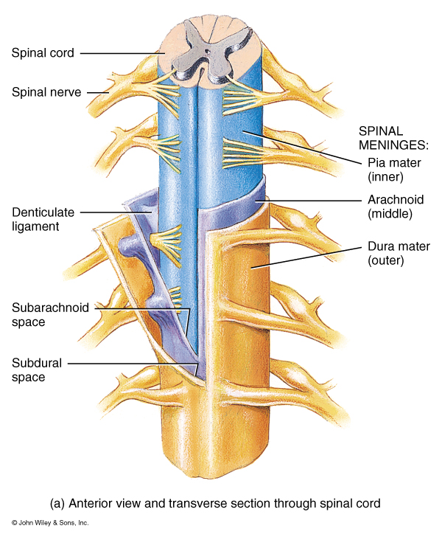
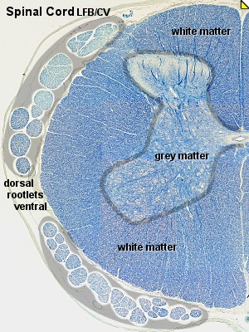
Organization of the CNS

Slide 8
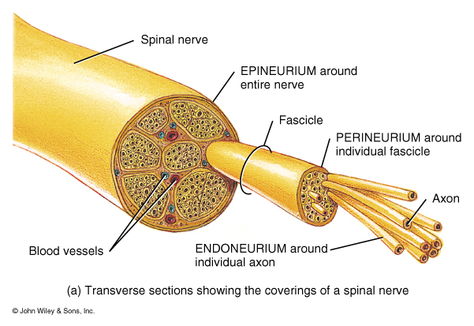
Organization of a Nerve of the PNS

Slide 9
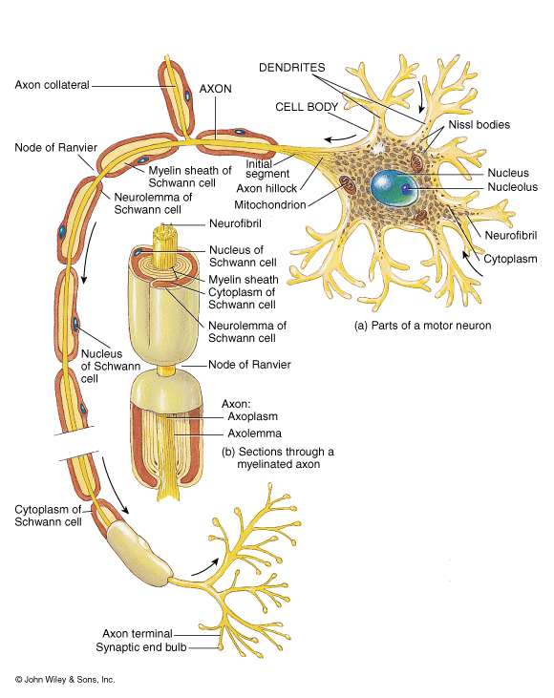
Introduction to the Nervous System and Nerve Tissue
Structure of a Neuron
Dendrites: Carry nerve
impulses toward cell body.
Receive stimuli from synapses or sensory receptors.
Cell Body: Contains nucleus and nissl bodies, a form of rough endoplasmic reticulum.
Axon: Carry nerve Impulses away from the cell bodies. Axons interact with muscle, glands, or other neurons.

Slide 10
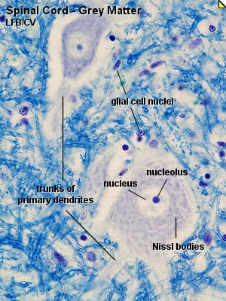
Multipolar “Motor” Neuron

Slide 11
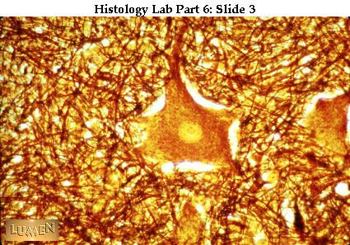
Multipolar “Motor” Neuron

Slide 12
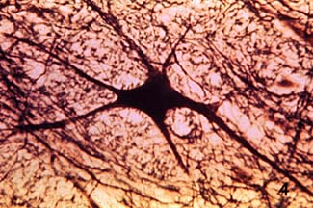
Multipolar “Motor” Neuron

Slide 13
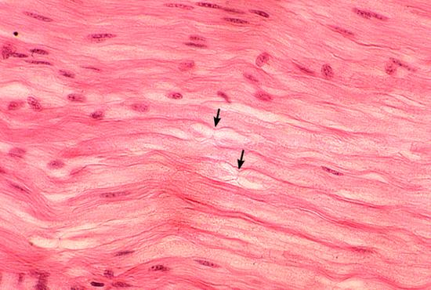
Node of Ranvier

Slide 14
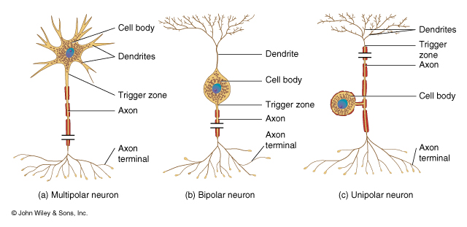
Introduction to the Nervous System and Nerve Tissue
Types of Neurons

Slide 15
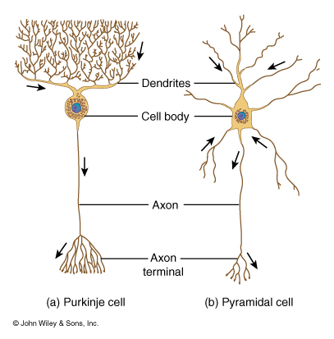
Introduction to the Nervous System and Nerve Tissue
Types of Interneurons

Slide 16
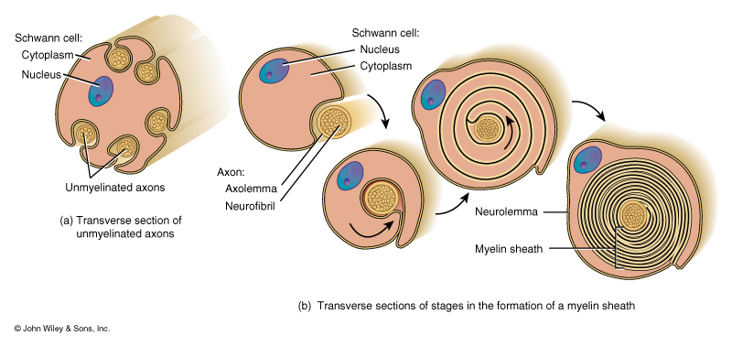
Introduction to the Nervous System and Nerve Tissue
Types of Supportive Cells of the PNS
1. Schwann cells that form the myelin sheath

Slide 17
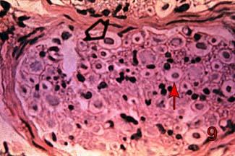
Introduction to the Nervous System and Nerve Tissue
Types of Supportive Cells of the PNS
1. Schwann cells that form the myelin sheath

Slide 18
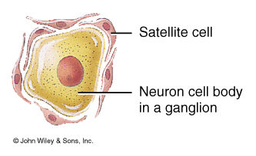
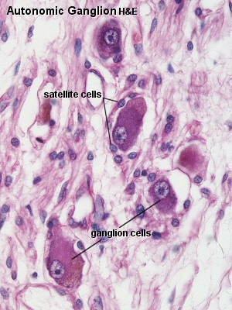
Introduction to the Nervous System and Nerve Tissue
Types of Supportive Cells of the PNS
1. Satellite cells associated with sensory neuron cell bodies

Slide 19
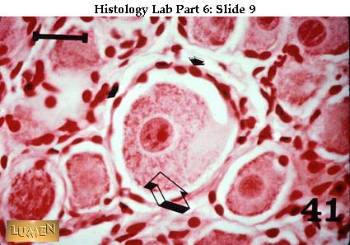
Introduction to the Nervous System and Nerve Tissue
Types of Supportive Cells of the PNS
1. Satellite cells associated with sensory neuron cell bodies

Slide 20
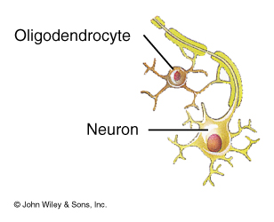
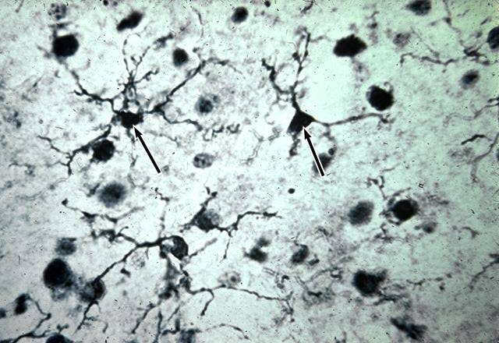
Introduction to the Nervous System and Nerve Tissue
Types of Supportive Cells of the CNS (Neuroglia)
1. Oligodendrocytes: form the myelin sheath of the CNS

Slide 21
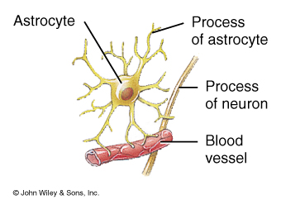
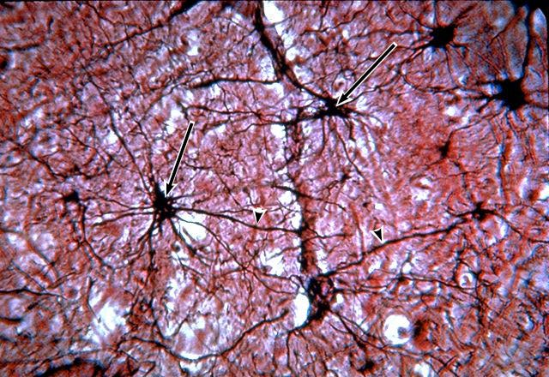
Introduction to the Nervous System and Nerve Tissue
Types of Supportive Cells of the CNS (Neuroglia)
2. Astrocytes: Help form the blood-brain barrier, support
the appropriate chemical environment for neurons.

Slide 22
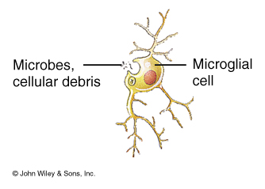
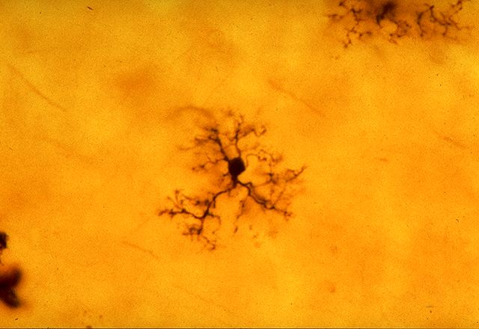
Introduction to the Nervous System and Nerve Tissue
Types of Supportive Cells of the CNS (Neuroglia)
3. Microglia: Phagocytes in the CNS that engulf
microbes and cellular debris.

Slide 23
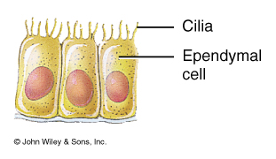
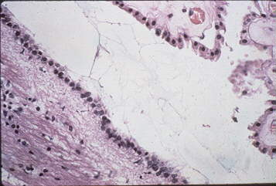
Introduction to the Nervous System and Nerve Tissue
Types of Supportive Cells of the CNS (Neuroglia)
4. Ependymal Cells: Form blood-brain barrier in the brain
ventricles and central canal of spinal cord. Produce cerebrospinal fluid and assist in its circulation.

Slide 24
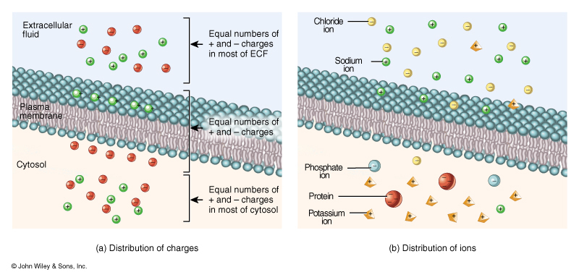
Nervous System Physiology: Distribution of Ions between
ECF and ICF

Slide 25
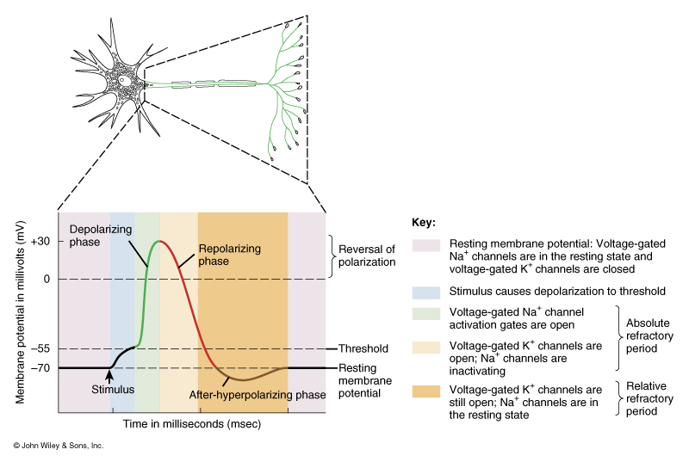
Nervous System Physiology:
Nerve Conduction Occurs because of Changes in Membrane Potential

Slide 26
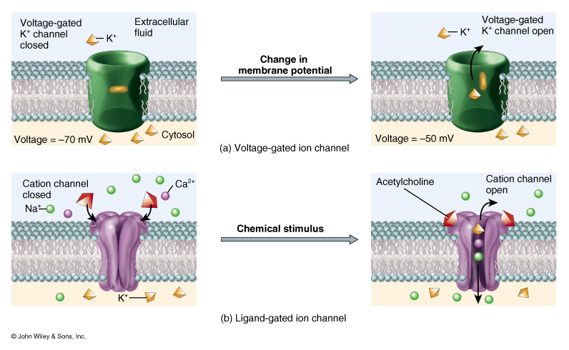
Nervous System Physiology:
Types of Channel Proteins

Slide 27
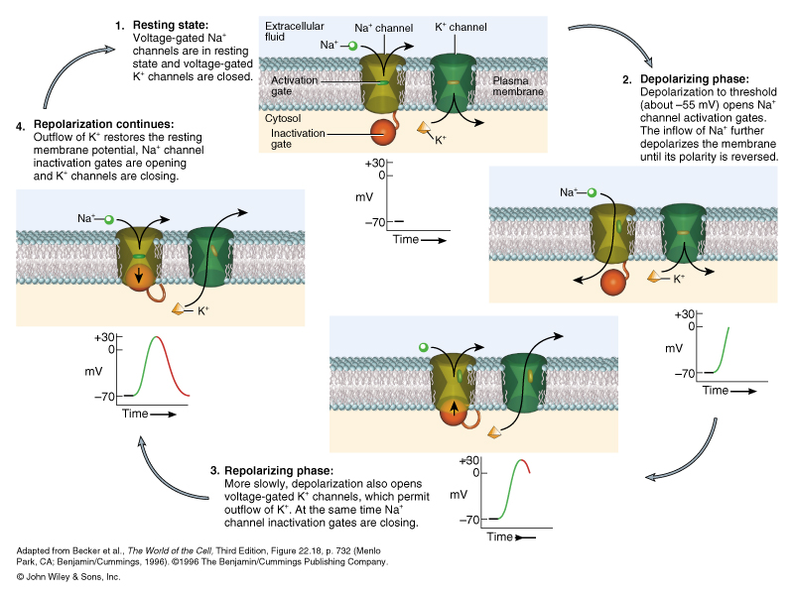
Nervous System Physiology:
Mechanism that creates an Action Potential

Slide 28
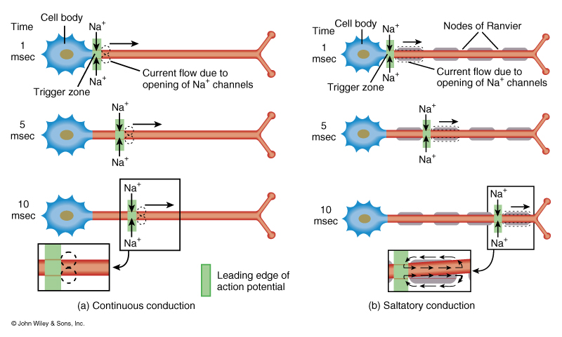
Nervous System Physiology:
Two Mechanisms of Action Potential Conduction along a neuron

Slide 29
Types of Nerve Fibers
“A” fibers: Largest diameter myelinated fibers with the fastest saltatory conduction (12-130 m/sec) and a brief absolute refractory period. Axons of motor neurons and axons of sensory neurons that conduct touch, pressure, and thermal sensations. (GSSN)
“B” fibers: intermediate diameter myelinated fibers
        With slower saltatory conduction then “A” fibers and longer absolute refractory periods. Dendrites of visceral sensory neurons and axons of presynaptic neurons of the ANS.

Slide 30
Types of Nerve Fibers
“C” fibers: Smallest diameter unmyelinated fibers with slow continuous conduction (.5 – 2 m/sec.) and the longest absolute refractory periods. Axons of some somatic sensory neuron that carry pain, touch, pressure and thermal sensation, neuron that carry visceral pain sensations, and postsynaptic neurons of the ANS

Slide 31
Comparison of Graded versus Action Potentials
Characteristics | Graded | Action
Origin | Dendrites and cell bodies | Trigger Zone 1st Node of Ranvier
Channels | Ligand-gated or mechanical | Voltage-gated
Conduction | Nonpropagated continuous | Propagated saltatory
Amplitude | Varies depending on strength of stimulus | All-or–None
Duration | Long- several msec. to minutes | Short- .5 – 2msec.
Polarity | Hyperpolarized or depolarized | Depolarized
Refractory period | No refractory period summation can occur | Absolute refractory period no summation

Slide 32
Nervous System Physiology: Communication between neurons at a synaptic junction
1. Electrical Synapses: Communication via gap junctions
between smooth muscle, cardiac muscle, and
some neurons of the CNS. Provide fast,
synchronized, and two-way transmission of
information.
2. Chemical Synapses: Communication via chemical
neurotransmitters that diffuse across a synaptic
cleft. Provides slow one-way information flow

Slide 33
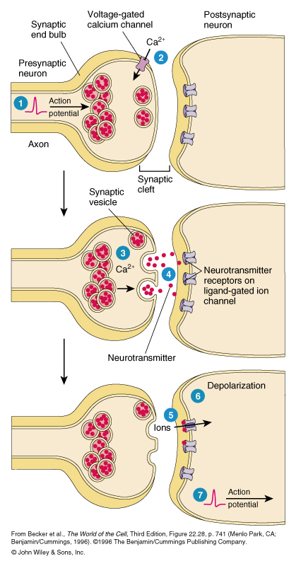
Nervous System Physiology: Communication between neurons at a synaptic junction
Action potential arrives at
a synaptic end bulb.
Depolarization of membrane
causes the opening of Ca2+
channels.
Increase in (Ca2+) inside of
presynaptic neuron triggers
exocytosis of neurotransmitter
Neurotransmitter diffuses across
synaptic cleft and binds to
receptor (ligand-gated channel)
on postsynaptic neuron

Slide 34
Nervous System Physiology: Communication between neurons at a synaptic junction
Na+ channels open causing a depolarization (Na+ channels)
EPSP (excitatory postsynaptic potential) or a hyperpolarization (Cl-
channels) IPSP (inhibitory post-
synaptic potential) of the postsynaptic neuron.
If depolarization reaches a threshold, an action potential is generated on the postsynaptic
neuron.

Slide 35
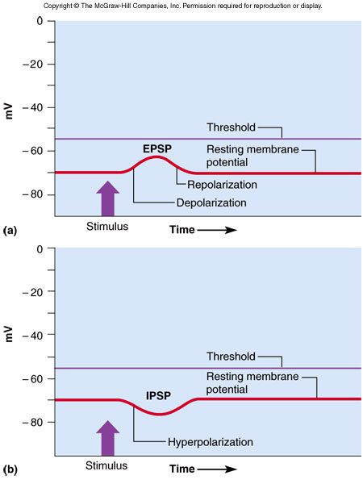
Nervous System Physiology: Communication between neurons at a synaptic junction

Slide 36
Nervous System Physiology: Communication between neurons at a synaptic junction
Neurotransmitters
Acetylcholine: Found in the PNS and CNS. EPSP and in parasympathetic neurons IPSP.
Amino Acids: Glutamate and Aspartate produce EPSP’s in the CNS. Gamma Aminobutyric Acid (GABA) produces IPSP’s in the CNS. Valium enhances the action of GABA.

Slide 37
Nervous System Physiology: Communication between neurons at a synaptic junction
Neurotransmitters
Biogenic Amines: Norepinephrine and epinephrine produce EPSP’s in the sympathetic system. Serotonin controls mood and induction of sleep.
Gases: Nitric Oxide produce by the enzyme nitric oxide synthase. Causes vasodilation and erection.

Slide 38
Nervous System Physiology: Communication between neurons at a synaptic junction
Neurotransmitters
Neuropeptides:
Substance P: Enhances perception of pain.
Endorphins: inhibit pain by blocking release of Substance P
ATP-Adenosine 5’-triphosphate
Between taste buds and nerves that carry taste sensations –Finer et. al. Science vol 310, 2005

Slide 39
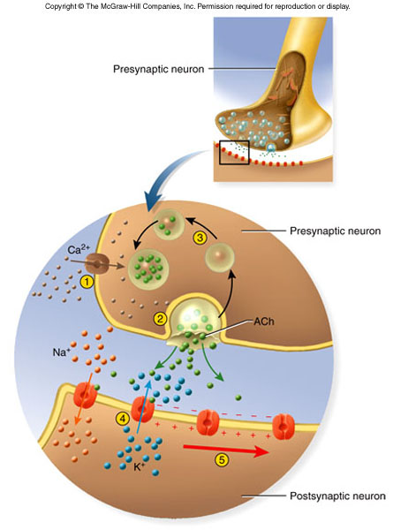
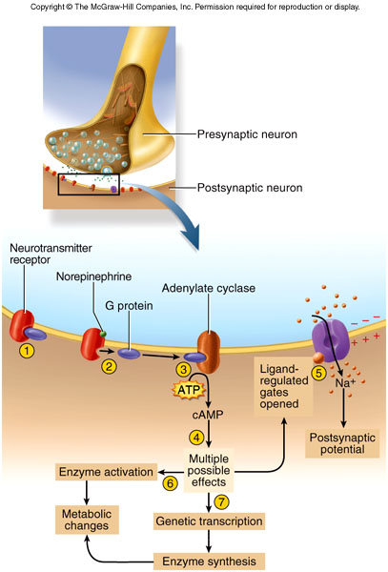
Nervous System Physiology: Communication between neurons at a synaptic junction

Slide 40
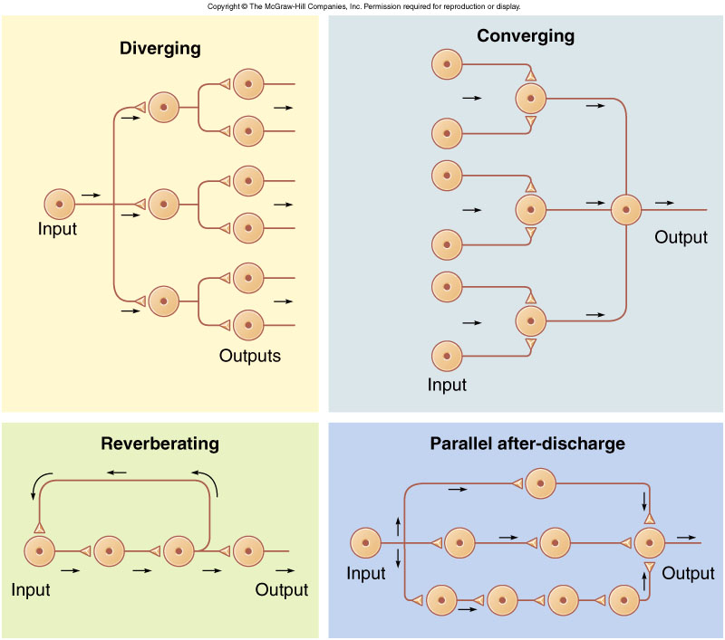
Types of Neural Circuits

Slide 41
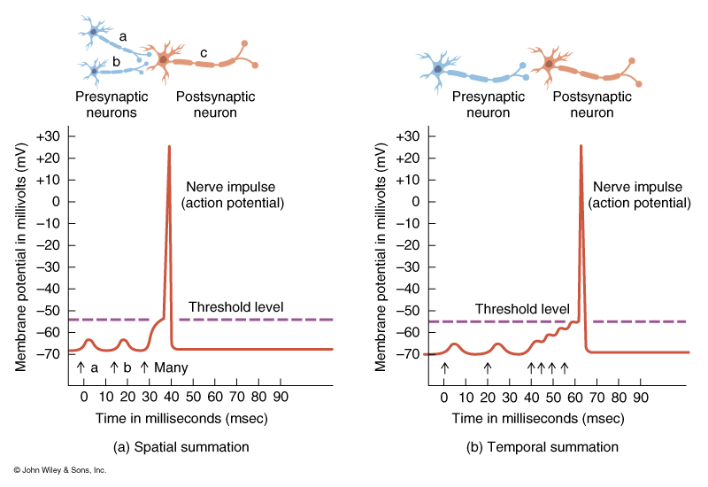
Summation at Synapses

Slide 42
Brain Waves
Alpha waves: (8 – 13 Hz) Occur when a person is awake, resting, mind wandering and eyes closed. Recorded in the parieto-occipital area.
Beta waves: (14 -30 Hz) Become accentuated during mental activity and sensory stimulation. Recorded in the frontal to parietal regions.

Slide 43
Brain Waves
Theta waves: (4 -7 Hz) Normal in children and drowsy or sleeping adults. Predominant waves in awake adults suggest emotional stress or brain disorders.
Delta waves: (< 3.5 Hz) High-amplitude wave. Infants exhibit these waves when awake and adults exhibit them in deep sleep. Increased delta waves in awake adults indicate serious brain damage.

